Slide 1
Topic 4; Error detection and coding
Media Access Control in Wired & Wireless Networks
datagram
Link layer protocol
Adapter
Adapter
frame
frame
Sender
Receiver

Slide 2
Topics
Encoding
Framing
Error detection
Reliable delivery
Access Mediation
Notes:
We have covered up till now that if we want to build a direct-link network (in which all nodes are connected together by one or more direct links – i.e., there are no switches), we have to cover five fundamental problems. These problems are listed above.
Encoding is primarily a layer 1 function but is implemented in network adapters. The encoding functionality converts data bits into signal form that can be sent on the physical medium. Framing is essential a layer-2 function and is also performed by a network adapter – the framing functionality is responsible mainly for determining the frame boundaries, and also contains addressing information.
However, there are other important functionalities that must be implemented if we want to make our direct link network useful. More specifically, we should have the ability to mediate requests for access to the network; this is necessary since physical links cannot accommodate arbitrary number of users. When multiple users want to transmit at the same time, the media access control (MAC) protocol must decide which node can transmit and which node should wait.
Our lecture today would be on access mediation techniques in networks. We will study access mediation for both wired and wireless networks. Note that we do not need to perform media access mediation on a point-to-point link assuming full-duplex links. PPP, however, assumes full-duplex links as is stated in the PPP RFC. (To know what an RFC is, see: http://en.wikipedia.org/wiki/Request_for_Comments)
With the assumption, that point-to-point links are full duplex, the MAC problem is relevant to multiple access networks. We have already named one example of a multiple-access network which is Ethernet (without delving into too much details). Ethernet is an example of a wired network, we will also study today the MAC problem for wireless networks. We will see that wireless networks have different characteristics than wired networks.

Slide 3
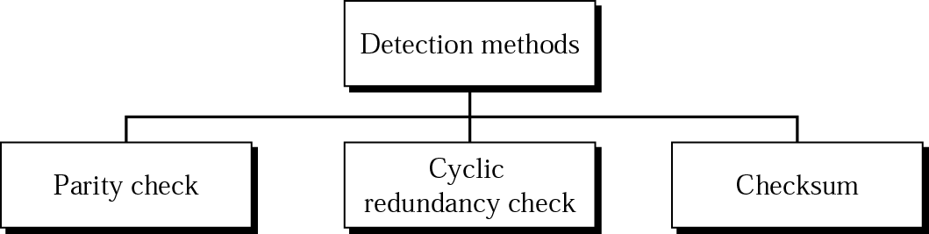
Error Detection
A major goal in designing error detection algorithms is to maximize the probability of detecting errors using only a small number of redundant bits.
Notes:
As discussed in previous lectures, bit errors are sometimes introduced into frames. This happens, for example, because of electrical interference or thermal noise. Although errors are rare, especially on optical links, some mechanism is needed to detect these errors so that corrective action can be taken.
There is a long history of techniques for dealing with bit errors in computer systems, dating back to Hamming and Reed/Solomon codes that were developed for use when storing data on magnetic disks and in early core memories. This section describes some of the error detection techniques most commonly used in networking.
One of the most common techniques for detecting transmission errors is a technique known as the cyclic redundancy check (CRC). It is used in nearly all the link-level protocols discussed in the previous classes—for example, HDLC, DDCMP—as well as in the CSMA and token ring protocols described in previous lectures. We will briefly describe the basic CRC algorithm. Before discussing that approach, we consider two simpler schemes that are also widely used: two-dimensional parity and checksums.
The former is used by the BISYNC protocol when it is transmitting ASCII characters (CRC is used as the error code when BISYNC is used to transmit EBCDIC), and the latter is used by several Internet protocols.

Slide 4
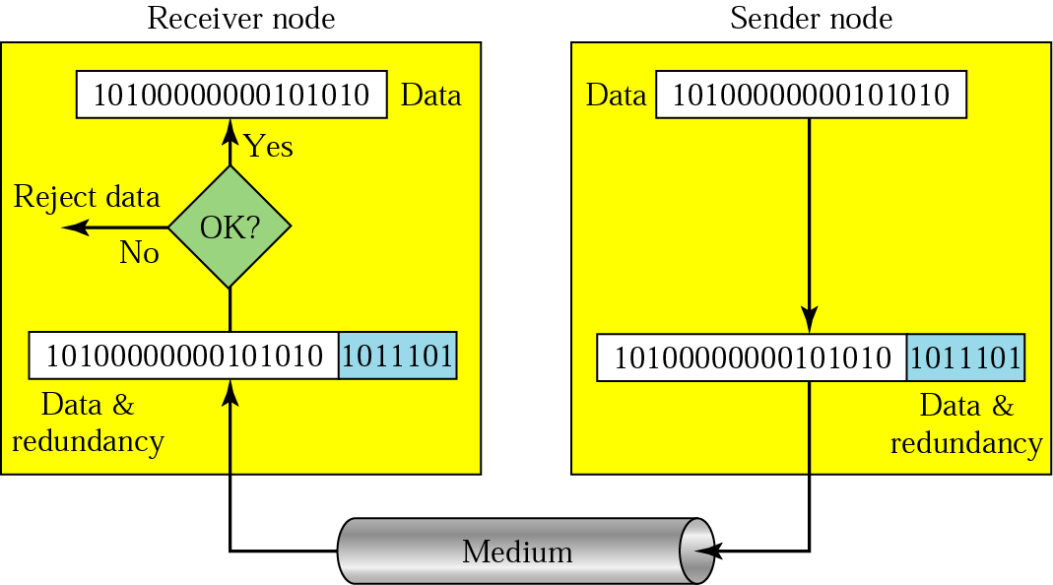
Error Detection
Notes:
As discussed in previous lectures, bit errors are sometimes introduced into frames. This happens, for example, because of electrical interference or thermal noise. Although errors are rare, especially on optical links, some mechanism is needed to detect these errors so that corrective action can be taken.
There is a long history of techniques for dealing with bit errors in computer systems, dating back to Hamming and Reed/Solomon codes that were developed for use when storing data on magnetic disks and in early core memories. This section describes some of the error detection techniques most commonly used in networking.
One of the most common techniques for detecting transmission errors is a technique known as the cyclic redundancy check (CRC). It is used in nearly all the link-level protocols discussed in the previous classes—for example, HDLC, DDCMP—as well as in the CSMA and token ring protocols described in previous lectures. We will briefly describe the basic CRC algorithm. Before discussing that approach, we consider two simpler schemes that are also widely used: two-dimensional parity and checksums.
The former is used by the BISYNC protocol when it is transmitting ASCII characters (CRC is used as the error code when BISYNC is used to transmit EBCDIC), and the latter is used by several Internet protocols.

Slide 5
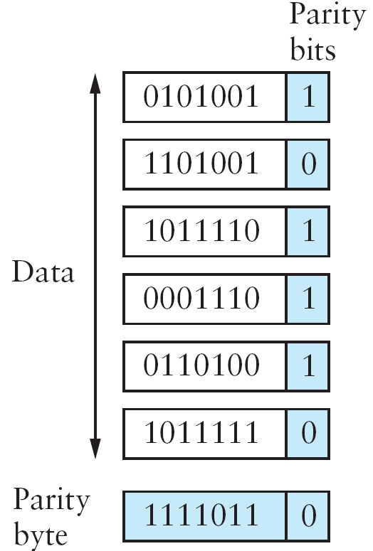
Repetition code – Naïve approach
Original Message
(n bits)
Repeated Message
(k bits)
Most errors detected with high probability
However, the overhead is very large (n = k bits)
Desired Goal:
Detect error with high probability but with k <<< n bits
Notes:
The basic idea behind any error detection scheme is to add redundant information to a frame that can be used to determine if errors have been introduced. In the extreme, we could imagine transmitting two complete copies of the data. If the two copies are identical at the receiver, then it is probably the case that both are correct. If they differ, then an error was introduced into one (or both) of them, and they must be discarded. This is a rather poor error detection scheme for two reasons. First, it sends n redundant bits for an n-bit message. Second, many errors will go undetected—any error that happens to corrupt the same bit positions in the first and second copies of the message.
Fortunately, we can do a lot better than this simple scheme. In general, we can provide quite strong error detection capability while sending only k redundant bits for an n-bit message, where k ≪ n. On an Ethernet, for example, a frame carrying up to 12,000 bits (1500 bytes) of data requires only a 32-bit CRC code, or as it is commonly expressed, uses CRC-32. Such a code will catch the overwhelming majority of errors, as we will see below.
We say that the extra bits we send are redundant because they add no new information to the message. Instead, they are derived directly from the original message using some well-defined algorithm. Both the sender and the receiver know exactly what that algorithm is. The sender applies the algorithm to the message to generate the redundant bits. It then transmits both the message and those few extra bits. When the receiver applies the same algorithm to the received message, it should (in the absence of errors) come up with the same result as the sender. It compares the result with the one sent to it by the sender. If they match, it can conclude (with high likelihood) that no errors were introduced in the message during transmission. If they do not match, it can be sure that either the message or the redundant bits were corrupted, and it must take appropriate action, that is, discarding the message, or correcting it if that is possible.

Slide 6
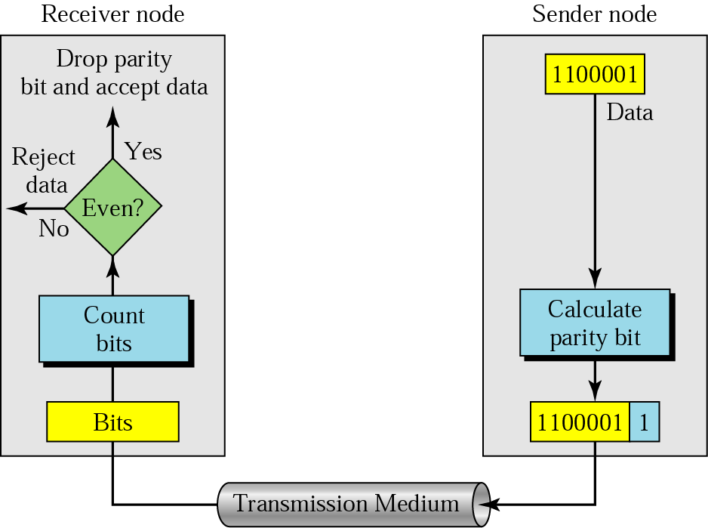
Single (even) parity bit
Can pick up odd number of bit errors (but not even) with low overhead
Notes:
Single parity bit checking can check all single-bit errors. It can also detect burst errors as long as the total number of bits changed is odd.
Single parity bit check is also called ‘Vertical Redundancy Check’

Slide 7
Single (even) parity bit
Parity bit
Simplest error detecting code
A single parity bit is appended so that the number of 1s always adds up to an even (or odd) number 1000000(1) 1111101(0)
Location of error is not determined, only occurrence
Only single bit error can be detected
If data is corrupted it must be discarded and re-transmitted by the sender

Slide 8
Single (even) parity bit
Parity bit
Data = 10001
Add parity 1^0^0^0^1^0 (even parity check)
100010 is sent
110010 is received
Receiver computes the parity (even)
1^1^0^0^1^0
Values for parity bit do not match
Discard

Slide 9
Two dimensional parity
Eff = # of total bits / # of msg bits
Ability to localize the error bit
Probability of more than one
error in the same row or col
low and can not be detected!
Better efficiency (Eff) for
longer rows of bits
One extra bit (parity bit) added to a 7-bit code
One parity byte for the entire frame
Catches all 1, 2, 3 and most 4 bit errors with some additional overhead
Notes:
Two-dimensional parity is exactly what the name suggests. It is based on “simple” (one-dimensional) parity, which usually involves adding one extra bit to a 7-bit code to balance the number of 1s in the byte. For example, odd parity sets the eighth bit to 1 if needed to give an odd number of 1s in the byte, and even parity sets the eighth bit to 1 if needed to give an even number of 1s in the byte. Two-dimensional parity does a similar calculation for each bit position across each of the bytes contained in the frame. This results in an extra parity byte for the entire frame, in addition to a parity bit for each byte.
The figure above illustrates how two-dimensional even parity works for an example frame containing 6 bytes of data. and most 4-bit errors. In this case, we Notice that the third bit of the parity byte is 1 since there are an odd number of 1s in the third bit across the 6 bytes in the frame. It can be shown that two-dimensional parity catches all 1-, 2-, and 3-bit errors, have added 14 bits of redundant information to a 49-bit message, and yet we have stronger protection against common errors than the “repetition code” described above.

Slide 10
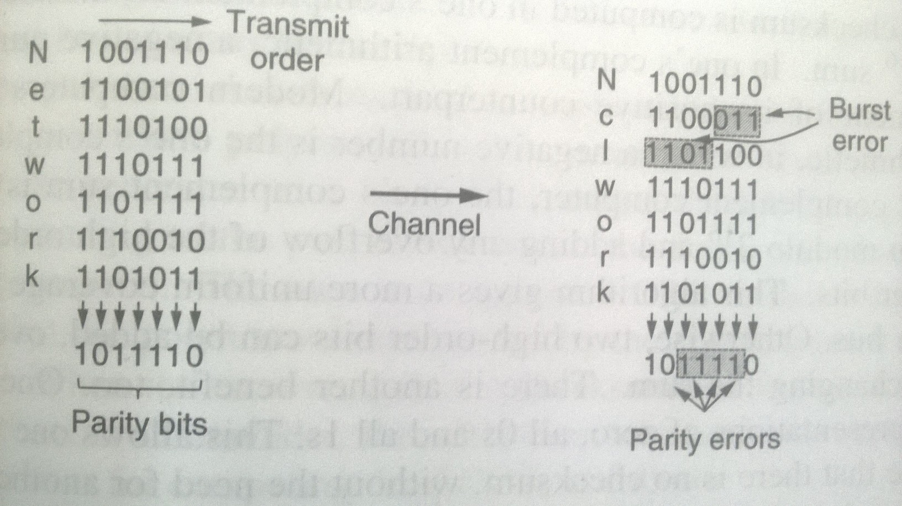
Two dimensional parity
Notes:
Two-dimensional parity is exactly what the name suggests. It is based on “simple” (one-dimensional) parity, which usually involves adding one extra bit to a 7-bit code to balance the number of 1s in the byte. For example, odd parity sets the eighth bit to 1 if needed to give an odd number of 1s in the byte, and even parity sets the eighth bit to 1 if needed to give an even number of 1s in the byte. Two-dimensional parity does a similar calculation for each bit position across each of the bytes contained in the frame. This results in an extra parity byte for the entire frame, in addition to a parity bit for each byte.
The figure above illustrates how two-dimensional even parity works for an example frame containing 6 bytes of data. Notice that the third bit of the parity byte is 1 since there are an odd number of 1s in the third bit across the 6 bytes in the frame. It can be shown that two-dimensional parity catches all 1-, 2-, and 3-bit errors, and most 4-bit errors. In this case, we have added 14 bits of redundant information to a 42-bit message, and yet we have stronger protection against common errors than the “repetition code” described above.

Slide 11
Example
Repeat the previous example for odd parity and introduce three bit errors during channel transmission. SEE if TDP detects it correctly or not?
Notes:
Two-dimensional parity is exactly what the name suggests. It is based on “simple” (one-dimensional) parity, which usually involves adding one extra bit to a 7-bit code to balance the number of 1s in the byte. For example, odd parity sets the eighth bit to 1 if needed to give an odd number of 1s in the byte, and even parity sets the eighth bit to 1 if needed to give an even number of 1s in the byte. Two-dimensional parity does a similar calculation for each bit position across each of the bytes contained in the frame. This results in an extra parity byte for the entire frame, in addition to a parity bit for each byte.
The figure above illustrates how two-dimensional even parity works for an example frame containing 6 bytes of data. Notice that the third bit of the parity byte is 1 since there are an odd number of 1s in the third bit across the 6 bytes in the frame. It can be shown that two-dimensional parity catches all 1-, 2-, and 3-bit errors, and most 4-bit errors. In this case, we have added 14 bits of redundant information to a 42-bit message, and yet we have stronger protection against common errors than the “repetition code” described above.

Slide 12
Checksum
At Tx
Add all 16 bit words
Take 1’s compliment of the sum
Transmit as Checksum
At Rx
Add all 16 bit words including checksum
Sum should be all 1’s if no error
Notes:
A second approach to error detection is exemplified by the Internet checksum. Although it is not used at the link level, it nevertheless provides the same sort of functionality as CRCs and parity, so we discuss it here. We will see examples of its use later on in this course as well.
The idea behind the Internet checksum is very simple—you add up all the words that are transmitted and then transmit the result of that sum. The result is called the checksum. The receiver performs the same calculation on the received data and compares the result with the received checksum. If any transmitted data, including the checksum itself, is corrupted, then the results will not match, so the receiver knows that an error occurred.
You can imagine many different variations on the basic idea of a checksum. The exact scheme used by the Internet protocols works as follows. Consider the data being checksummed as a sequence of 16-bit integers. Add them together using 16-bit ones complement arithmetic (explained below) and then take the ones complement of the result. That 16-bit number is the checksum.
Compared to our repetition code, this algorithm scores well for using a small number of redundant bits—only 16 for a message of any length—but it does not score extremely well for strength of error detection. For example, a pair of single-bit errors, one of which increments a word, one of which decrements another word by the same amount, will go undetected. The reason for using an algorithm like this in spite of its relatively weak protection against errors (compared to a CRC, for example) is simple: This algorithm is much easier to implement in software. Experience in the ARPANET suggested that a checksum of this form was adequate. One reason it is adequate is that this checksum is the last line of defense in an end-to-end protocol; the majority of errors are picked up by stronger error detection algorithms, such as CRCs, at the link level.

Slide 13
Checksum
Data to be sent: 10110011 (Seg 1)
10101011
--------------
01011110
1 (carry)
--------------
01011111 (Sum)
10100000 (Checksum) [1s complement]
As we have to wrap up the bits in K segments (equal to the size of the segment), so we wrap the total sum into 8 bits.
Sender sends the sum plus the checksum. Receiver computes the sum again which should come out to be all one’s in case of no errors.
Notes:
A second approach to error detection is exemplified by the Internet checksum. Although it is not used at the link level, it nevertheless provides the same sort of functionality as CRCs and parity, so we discuss it here. We will see examples of its use later on in this course as well.
The idea behind the Internet checksum is very simple—you add up all the words that are transmitted and then transmit the result of that sum. The result is called the checksum. The receiver performs the same calculation on the received data and compares the result with the received checksum. If any transmitted data, including the checksum itself, is corrupted, then the results will not match, so the receiver knows that an error occurred.
You can imagine many different variations on the basic idea of a checksum. The exact scheme used by the Internet protocols works as follows. Consider the data being checksummed as a sequence of 16-bit integers. Add them together using 16-bit ones complement arithmetic (explained below) and then take the ones complement of the result. That 16-bit number is the checksum.
Compared to our repetition code, this algorithm scores well for using a small number of redundant bits—only 16 for a message of any length—but it does not score extremely well for strength of error detection. For example, a pair of single-bit errors, one of which increments a word, one of which decrements another word by the same amount, will go undetected. The reason for using an algorithm like this in spite of its relatively weak protection against errors (compared to a CRC, for example) is simple: This algorithm is much easier to implement in software. Experience in the ARPANET suggested that a checksum of this form was adequate. One reason it is adequate is that this checksum is the last line of defense in an end-to-end protocol; the majority of errors are picked up by stronger error detection algorithms, such as CRCs, at the link level.

Slide 14
Checksum
Extra credit to first student:
Data to be sent: 10110011101010110101110001110011
Compute the checksum and check if the data received by receiver has any errors or not
Notes:
A second approach to error detection is exemplified by the Internet checksum. Although it is not used at the link level, it nevertheless provides the same sort of functionality as CRCs and parity, so we discuss it here. We will see examples of its use later on in this course as well.
The idea behind the Internet checksum is very simple—you add up all the words that are transmitted and then transmit the result of that sum. The result is called the checksum. The receiver performs the same calculation on the received data and compares the result with the received checksum. If any transmitted data, including the checksum itself, is corrupted, then the results will not match, so the receiver knows that an error occurred.
You can imagine many different variations on the basic idea of a checksum. The exact scheme used by the Internet protocols works as follows. Consider the data being checksummed as a sequence of 16-bit integers. Add them together using 16-bit ones complement arithmetic (explained below) and then take the ones complement of the result. That 16-bit number is the checksum.
Compared to our repetition code, this algorithm scores well for using a small number of redundant bits—only 16 for a message of any length—but it does not score extremely well for strength of error detection. For example, a pair of single-bit errors, one of which increments a word, one of which decrements another word by the same amount, will go undetected. The reason for using an algorithm like this in spite of its relatively weak protection against errors (compared to a CRC, for example) is simple: This algorithm is much easier to implement in software. Experience in the ARPANET suggested that a checksum of this form was adequate. One reason it is adequate is that this checksum is the last line of defense in an end-to-end protocol; the majority of errors are picked up by stronger error detection algorithms, such as CRCs, at the link level.

Slide 15
Cyclic Redundancy Check
Cyclic Redundancy Check (CRC)
Used to detect presence of errors
Frame bits are seen as polynomial M(x)
e.g. 101001 => M(x) = x⁵ + x³ + 1
Generator can also be viewed as a polynomial
e.g. 10001 => G(x) = x⁴ + 1

Slide 16
Cyclic Redundancy Check
Sender and receiver agree on the generator polynomial G(x) with degree r
Both high and low order bits of polynomial G(x) MUST be 1 i.e., 1XXXX1
Frame polynomial M(x) must be longer than the Generator polynomial G(x)
Checksum is appended at the end of the frame with one condition
Polynomial generated by the check-summed frame is divisible by G(x)
We call the transmitted frame T(x)

Slide 17
Cyclic Redundancy Check
Receiver gets the check summed frame T(x) with errors E(x)
Tries to divide it by G(x), known in advance
If there is a remainder, there has been an error
IMPORTANT
No carries in addition
No borrows in subtraction

Slide 18
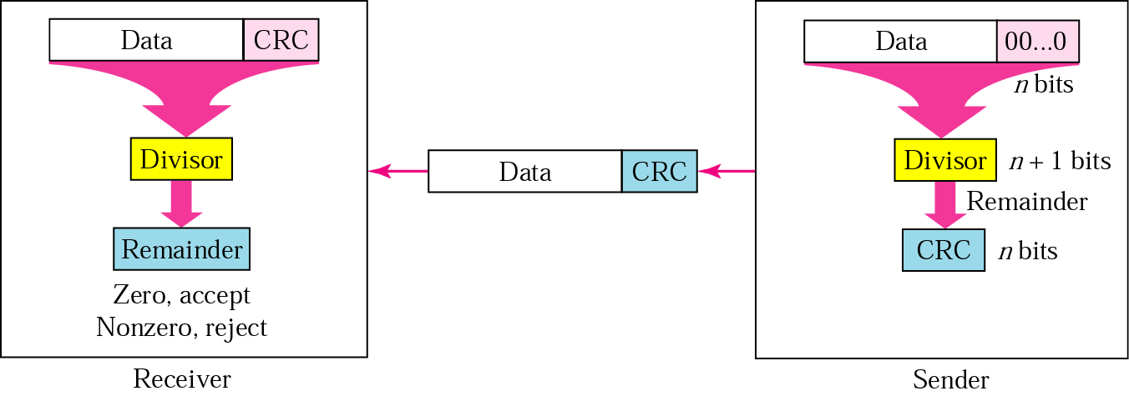
Cyclic Redundancy Check
To be valid, a CRC must have two properties:
1) CRC should have one less bit than the divisor
2) Appending CRC to data string makes it exactly divisible by divisor
Notes:
Cyclic redundancy checks use some fairly powerful mathematics to achieve this goal. For example, a 32-bit CRC gives strong protection (probability of catching error of the order of 99.99%) against common bit errors in messages that are thousands of bytes long. The theoretical foundation of the cyclic redundancy check is rooted in a branch of mathematics called finite fields. We will not delve too much into the mathematical details but will provided a high-level view.

Slide 19
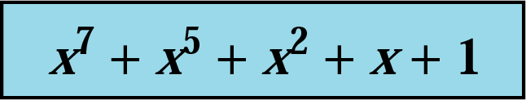
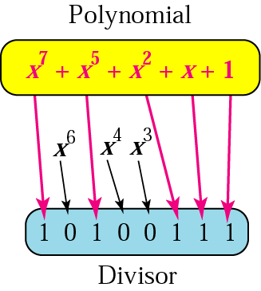
CRC Divisor Polynomial
Notes:
To be valid, a CRC must have two properties:
The CRC should have exactly one bit less than the divisor.
Appending it to the end of the data string must make it exactly divisible by the divisor.

Slide 20
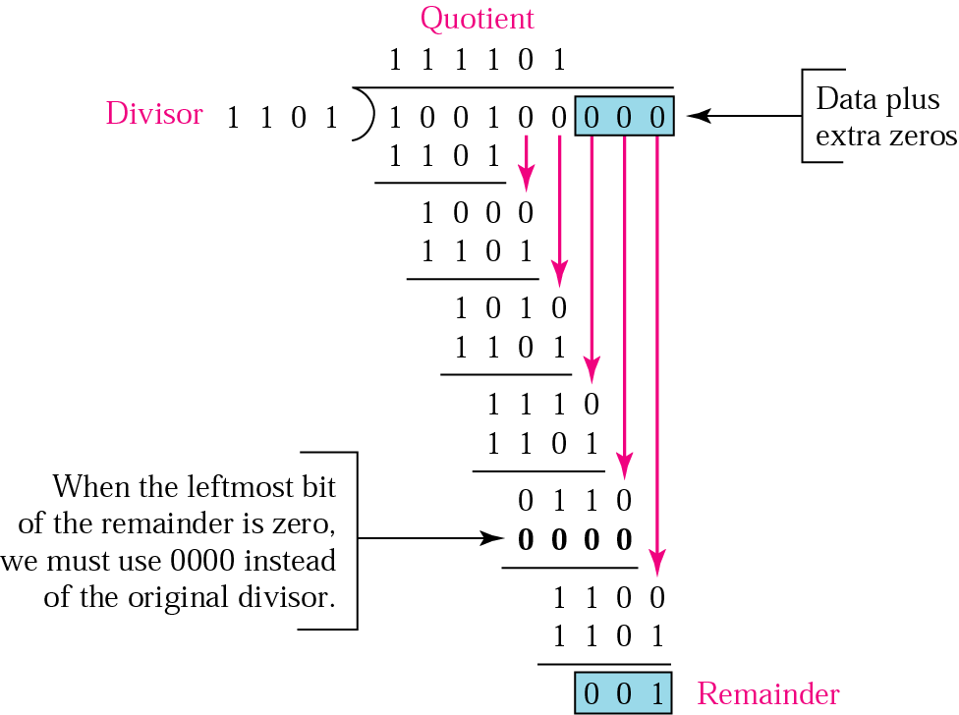
Cyclic Redundancy Check
Sender
Notes:
To be valid, a CRC must have two properties:
The CRC should have exactly one bit less than the divisor.
Appending it to the end of the data string must make it exactly divisible by the divisor.

Slide 21
Cyclic Redundancy Check
Receiver
CRC
If remainder is zero, accept
Notes:
To be valid, a CRC must have two properties:
The CRC should have exactly one bit less than the divisor.
Appending it to the end of the data string must make it exactly divisible by the divisor.

Slide 22
Cyclic Redundancy Check
Mandatory for all students to attempt:
Compute the CRC for M(x) = x⁵ + x³ + 1
And G(x) = x³ + 1
Assume that there are burst errors during transmission and two of the bits are reversed. Show the detection at the receiver end

Slide 23
Part II - Reliable Transmission
Detecting errors is only one part of the problem. The other part is correcting errors once detected. There are two basic approaches that can be taken when the recipient of a message detects an error.
One is to notify the sender that the message was corrupted so that the sender can retransmit a copy of the message (called Automatic Repeat Request Protocols). If bit errors are rare, then in all probability the retransmitted copy will be error-free.
Alternatively, there are some types of error detection algorithms that allow the recipient to reconstruct the correct message even after it has been corrupted; such algorithms are called Forward Error Correction protocols.
Notes:
While some error codes are strong enough also to correct errors, in practice the overhead is typically too large to handle the range of bit and burst errors that can be introduced on a network link. Even when error-correcting codes are used (e.g., on wireless links), some errors will be too severe to be corrected. As a result, some corrupt frames must be discarded. A link-level protocol that wants to deliver frames reliably must somehow recover from these discarded (lost) frames. This is usually accomplished using a combination of two fundamental mechanisms—acknowledgments and timeouts. An acknowledgment (ACK for short) is a small control frame that a protocol sends back to its peer saying that it has received an earlier frame. By control frame we mean a header without any data, although a protocol can piggyback an ACK on a data frame it just happens to be sending in the opposite direction. The receipt of an acknowledgment indicates to the sender of the original frame that its frame was successfully delivered. If the sender does not receive an acknowledgment after a reasonable amount of time, then it retransmits the original frame. This action of waiting a reasonable amount of time is called a timeout.
The general strategy of using acknowledgments and timeouts to implement reliable delivery is sometimes called automatic repeat request (normally abbreviated ARQ). This section describes three different ARQ algorithms using generic language; that is, we do not give detailed information about a particular protocol’s header fields.

Slide 24
Part II - Reliable Transmission
A link-level protocol that wants to deliver frames reliably must somehow recover discarded (lost) frames. This is usually accomplished using a combination of two fundamental mechanisms—acknowledgments and timeouts.
An acknowledgment (ACK for short) is a small control frame that a protocol sends back to its peer saying that it has received an earlier frame.
If the sender does not receive an acknowledgment after a reasonable amount of time, then it retransmits the original frame. This action of waiting a reasonable amount of time is called a timeout.
Notes:
While some error codes are strong enough also to correct errors, in practice the overhead is typically too large to handle the range of bit and burst errors that can be introduced on a network link. Even when error-correcting codes are used (e.g., on wireless links), some errors will be too severe to be corrected. As a result, some corrupt frames must be discarded. A link-level protocol that wants to deliver frames reliably must somehow recover from these discarded (lost) frames. This is usually accomplished using a combination of two fundamental mechanisms—acknowledgments and timeouts. An acknowledgment (ACK for short) is a small control frame that a protocol sends back to its peer saying that it has received an earlier frame. By control frame we mean a header without any data, although a protocol can piggyback an ACK on a data frame it just happens to be sending in the opposite direction. The receipt of an acknowledgment indicates to the sender of the original frame that its frame was successfully delivered. If the sender does not receive an acknowledgment after a reasonable amount of time, then it retransmits the original frame. This action of waiting a reasonable amount of time is called a timeout.
The general strategy of using acknowledgments and timeouts to implement reliable delivery is sometimes called automatic repeat request (normally abbreviated ARQ). This section describes three different ARQ algorithms using generic language; that is, we do not give detailed information about a particular protocol’s header fields.

Slide 25
Part II - Reliable Transmission
Automatic Repeat Request (ARQ) – Error Control
Stop and wait
Sliding windows
Forward Error Correction (FEC)
Selective Repeat
Go back N
Automatic Repeat Request (ARQ) – Error Control
Notes:
While some error codes are strong enough also to correct errors, in practice the overhead is typically too large to handle the range of bit and burst errors that can be introduced on a network link. Even when error-correcting codes are used (e.g., on wireless links), some errors will be too severe to be corrected. As a result, some corrupt frames must be discarded. A link-level protocol that wants to deliver frames reliably must somehow recover from these discarded (lost) frames. This is usually accomplished using a combination of two fundamental mechanisms—acknowledgments and timeouts. An acknowledgment (ACK for short) is a small control frame that a protocol sends back to its peer saying that it has received an earlier frame. By control frame we mean a header without any data, although a protocol can piggyback an ACK on a data frame it just happens to be sending in the opposite direction. The receipt of an acknowledgment indicates to the sender of the original frame that its frame was successfully delivered. If the sender does not receive an acknowledgment after a reasonable amount of time, then it retransmits the original frame. This action of waiting a reasonable amount of time is called a timeout.
The general strategy of using acknowledgments and timeouts to implement reliable delivery is sometimes called automatic repeat request (normally abbreviated ARQ). This section describes three different ARQ algorithms using generic language; that is, we do not give detailed information about a particular protocol’s header fields.

Slide 26
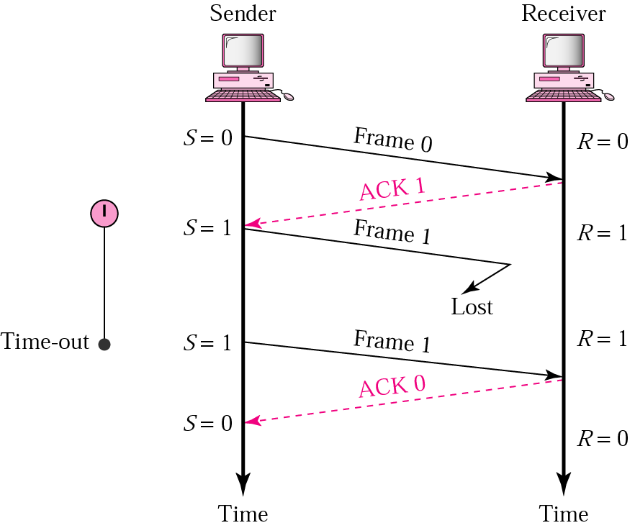
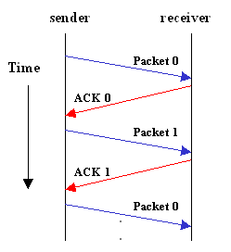
Stop and Wait Protocol
Notes:
The simplest ARQ scheme is the stop-and-wait algorithm. The idea of stop-and-wait is straightforward: After transmitting one frame, the sender waits for an acknowledgment before transmitting the next frame. If the acknowledgment does not arrive after a certain period of time, the sender times out and retransmits the original frame.
This slide and the next three slides illustrate four different scenarios that result from this basic algorithm (normal operation, lost packet, lost ACK, delayed ACK). Recall that by “lost” we mean that the frame was corrupted while in transit, that this corruption was detected by an error code on the receiver, and that the frame was subsequently discarded.

Slide 27
Stop and Wait’s Drawbacks
Frame delivered reliably and in order
but
Only one frame can be sent per RTT
Example:
BW= 1.5 Mbps; RTT= 45ms; Frame size = 1 KB
Throughput: 1 frame/ RTT = 1KB*8 bits per 45 ms
= 182 kbps (instead of 1.5 Mbps)
Delay x BW product: 67.5 Kb (~8 KB)
Notes:
The main shortcoming of the stop-and-wait algorithm is that it allows the sender to have only one outstanding frame on the link at a time, and this may be far below the link’s capacity. Consider, for example, a 1.5-Mbps link with a 45-ms round-trip time. This link has a delay × bandwidth product of 67.5 Kb, or approximately 8 KB. Since the sender can send only one frame per RTT, and assuming a frame size of 1 KB, this implies a maximum sending rate of
BitsPerFrame ÷ TimePerFrame
= 1024 × 8 ÷ 0.045
= 182 Kbps
or about one-eighth of the link’s capacity. To use the link fully, then, we’d like the sender to be able to transmit up to eight frames before having to wait for an acknowledgment.
Bandwidth delay product is a measurement of how many bits can fill up a network link. It gives the maximum amount of data that can be transmitted by the sender at a given time before waiting for acknowledgment

Slide 28
Sliding windows (SW): SR
Retransmission requests
– Implicit
The receiver acknowledges every good packet, packets that are not ACKed before a time-out are assumed lost or in error. Notice that this approach must be used to be sure that every packet is eventually received
– Explicit
An explicit NAK (selective reject) can request retransmission of just one packet
This approach can expedite the retransmission but is not strictly needed
–One or both approaches are used in practice

Slide 29
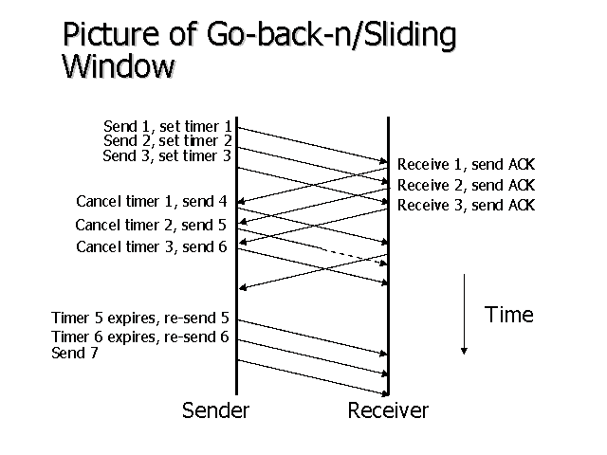
Sliding Window
Notes:
The main shortcoming of the stop-and-wait algorithm is that it allows the sender to have only one outstanding frame on the link at a time, and this may be far below the link’s capacity. Consider, for example, a 1.5-Mbps link with a 45-ms round-trip time. This link has a delay × bandwidth product of 67.5 Kb, or approximately 8 KB. Since the sender can send only one frame per RTT, and assuming a frame size of 1 KB, this implies a maximum sending rate of
BitsPerFrame ÷ TimePerFrame
= 1024 × 8 ÷ 0.045
= 182 Kbps
or about one-eighth of the link’s capacity. To use the link fully, then, we’d like the sender to be able to transmit up to eight frames before having to wait for an acknowledgment.

Slide 30
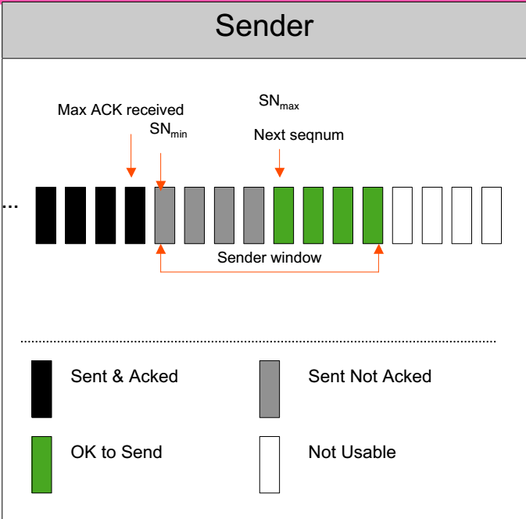
Sliding Window

Slide 31
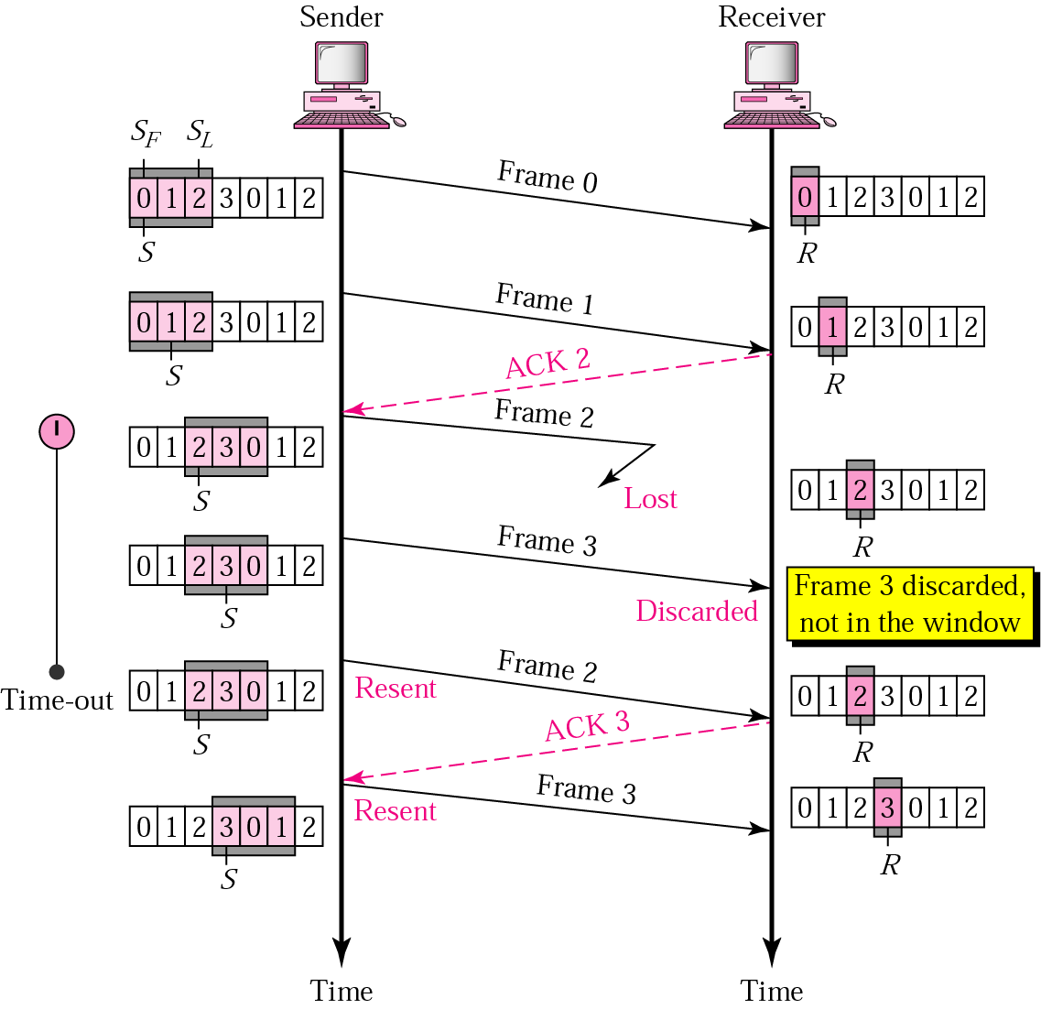
Sliding windows (SW): Go-back-N

Slide 32
Sliding windows (SW): Go-back-N
Go-back-N ARQ is inefficient because of the need to transmit all frames subsequent to an error frame.
An alternative to Go-back-N ARQ is the Selective Repeat ARQ.
3. Selective repeat ARQ has three differences from Go-back ARQ.
Receiver window size is increased so that out of order error-free frames can be accepted
Retransmission mechanism is modified so that individual frames can be retransmitted
In addition to ACK command, the receiver can also send a NACK command corresponding to the frame not received in a sequence of frames. Whenever an out of sequence frame is received, an NAK frame is transmitted.

Slide 33
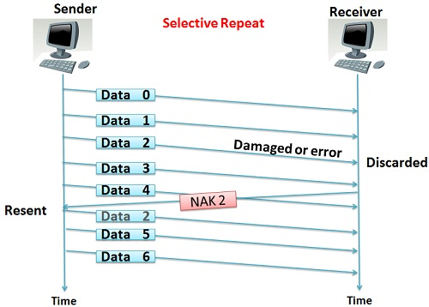
Sliding windows (SW): SR
Notes:
http://techdifferences.com/difference-between-go-back-n-and-selective-repeat-protocol.html

Slide 34
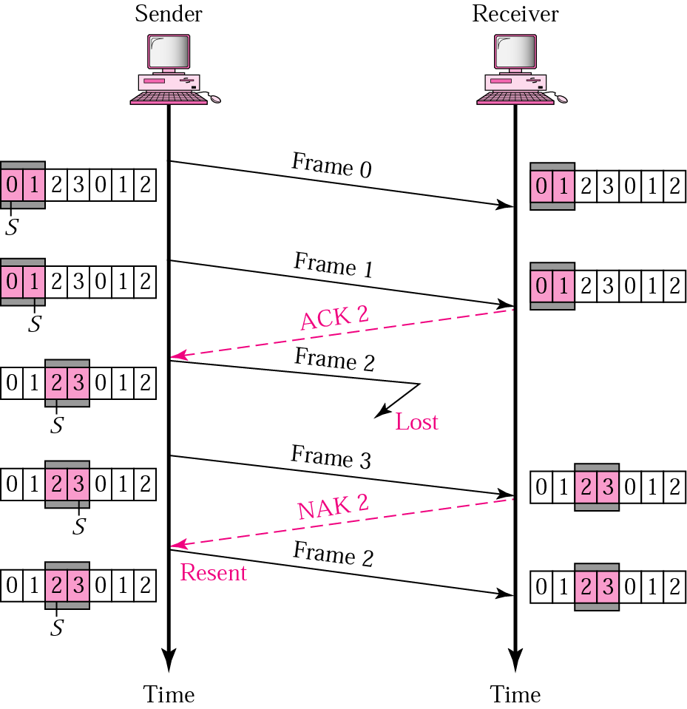
SW: Selective Repeat
When used as the protocol for the delivery of messages, the sending process continues to send a number of frames specified by a window size even after a frame loss. Unlike Go-Back-N ARQ, the receiving process will continue to accept and acknowledge frames sent after an initial error.
Notes:
When used as the protocol for the delivery of messages, the sending process continues to send a number of frames specified by a window size even after a frame loss. Unlike Go-Back-N ARQ, the receiving process will continue to accept and acknowledge frames sent after an initial error.

Slide 35
1
Throughput in computer networks

Slide 36
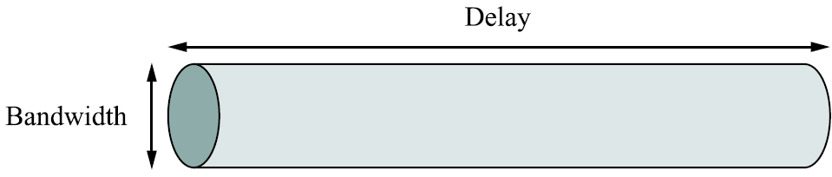
Throughput and bandwidth
The theoretical number of bits that can be sent per second = bandwidth
The measured number of bits that can be successfully sent per second = throughput
Instantaneous and average throughput
Notes:
Bandwidth and throughput are two of the most confusing terms used in networking; primarily, because it can be defined in various ways.
Bandwidth is literally the width of frequency band; e.g., voice-grade telephone can support frequencies from 300 Hz to 3300 Hz and said to have a bandwidth of 3KHz.
When we talk to bandwidth of a link, we usually refer to the number of bits per second that can be transmitted on the link. We might say that the bandwidth of an Ethernet link is 10 Mbps. This is also referred to as the throughput.
More generally, we tend to use the term throughput to refer to the measured performance of the system. E.g., due to various inefficiencies, a pair of nodes connected by a link of 10 Mbps may achieve a throughput of only 2 Mbps.
We can also talk of the bandwidth required by an application (in bps). This will be covered again in the last slide.

Slide 37
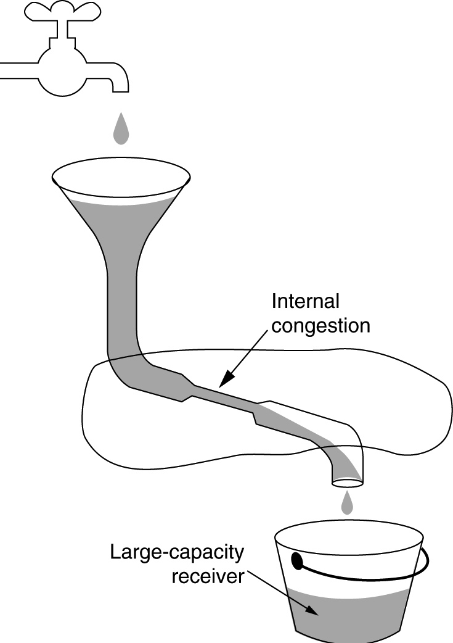
End to end throughput
End to end throughput is typically limited by the bottleneck link
Source
Fluid dynamics analogy
Bottleneck link
Receiver
Figure Credit: “Computer Networks” by Tanenbaum
Notes:
Bandwidth and throughput are two of the most confusing terms used in networking; primarily, because it can be defined in various ways.
Bandwidth is literally the width of frequency band; e.g., voice-grade telephone can support frequencies from 300 Hz to 3300 Hz and said to have a bandwidth of 3KHz.
When we talk to bandwidth of a link, we usually refer to the number of bits per second that can be transmitted on the link. We might say that the bandwidth of an Ethernet link is 10 Mbps. This is also referred to as the throughput.
More generally, we tend to use the term throughput to refer to the measured performance of the system. E.g., due to various inefficiencies, a pair of nodes connected by a link of 10 Mbps may achieve a throughput of only 2 Mbps.
We can also talk of the bandwidth required by an application (in bps). This will be covered again in the last slide.

Slide 38
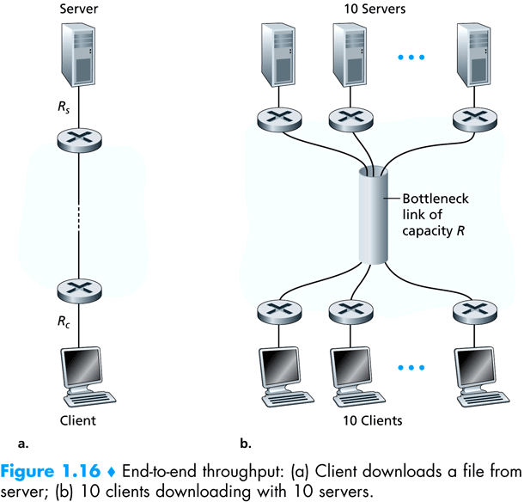
Client downloads a file from server
10 clients downloading with 10 servers
Figure Credit: “Computer Networking: A Top Down Approach” by Kurose and Ross
Notes:
Bandwidth and throughput are two of the most confusing terms used in networking; primarily, because it can be defined in various ways.
Bandwidth is literally the width of frequency band; e.g., voice-grade telephone can support frequencies from 300 Hz to 3300 Hz and said to have a bandwidth of 3KHz.
When we talk to bandwidth of a link, we usually refer to the number of bits per second that can be transmitted on the link. We might say that the bandwidth of an Ethernet link is 10 Mbps. This is also referred to as the throughput.
More generally, we tend to use the term throughput to refer to the measured performance of the system. E.g., due to various inefficiencies, a pair of nodes connected by a link of 10 Mbps may achieve a throughput of only 2 Mbps.
We can also talk of the bandwidth required by an application (in bps). This will be covered again in the last slide.

Slide 39
2
Delay in
computer networks

Slide 40
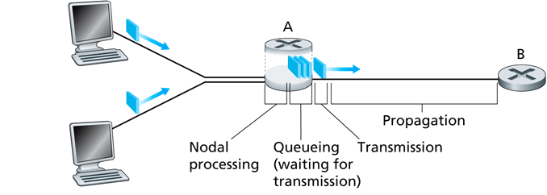
Nodal delay
Figure Credit: “Computer Networking: A Top Down Approach” by Kurose and Ross
Notes:
Processing Delay
The time required to examine the packet's header and determine where to direct the packet is part of the processing delay. The processing delay can also include other factors, such as the time needed to check for bit-level errors in the packet that occurred in transmitting the packet's bits from the upstream node to router A. Processing delays in high-speed routers are typically on the order of microseconds or less. After this nodal processing, the router directs the packet to the queue that precedes the link to router B.
Queueing delay:
At the queue, the packet experiences a queuing delay as it waits to be transmitted onto the link. The length of the queuing delay of a specific packet will depend on the number of earlier-arriving packets that are queued and waiting for transmission across the link. If the queue is empty and no other packet is currently being transmitted, then our packet's queuing delay will be zero. On the other hand, if the traffic is heavy and many other packets are also waiting to be transmitted, the queuing delay will be long. We will see shortly that the number of packets that an arriving packet might expect to find is a function of the intensity and nature of the traffic arriving at the queue. Queuing delays can be on the order of microseconds to milliseconds in practice.
Transmission Delay
Assuming that packets are transmitted in a first-come-first-served manner, as is common in packet-switched networks, our packet can be transmitted only after all the
packets that have arrived before it have been transmitted. Denote the length of the packet by L bits, and denote the transmission rate of the link from router A to router B by R bits/sec. For example, for a 10 Mbps Ethernet link, the rate is R = 10 Mbps; for a 100 Mbps Ethernet link, the rate is R = 100 Mbps. The transmission delay (also called the store-and-forward delay, as discussed in Section 1.3) is L/R. This is the amount of time required to push (that is, transmit) all of the packet's bits into the link. Transmission delays are typically on the order of microseconds to milliseconds in practice.
Propagation Delay
Once a bit is pushed into the link, it needs to propagate to router B. The time required to propagate from the beginning of the link to router B is the propagation
delay. The bit propagates at the propagation speed of the link. The propagation speed depends on the physical medium of the link (that is, fiber optics, twisted-pair
copper wire, and so on) and is in the range of 2 x 10^8 meters/sec to 3 x 10^8 meters/sec which is equal to, or a little less than, the speed of light. The propagation delay is the distance between two routers divided by the propagation speed. That is, the propagation delay is d/s, where d is the distance between router A and router B and s is the propagation speed of the link. Once the last bit of the packet propagates to node B, it and all the preceding bits of the packet are stored in router B. The whole process then continues with router B now performing the forwarding. In wide-area networks, propagation delays are on the order of milliseconds.

Slide 41
Nodal delay
Processing Delay
The time required to examine the packet's header and determine where to direct the packet is part of the processing delay
Queueing delay:
At the queue, the packet experiences a queuing delay as it waits to be transmitted onto the link. The length of the queuing delay of a specific packet will depend on the number of earlier-arriving packets that are queued
Figure Credit: “Computer Networking: A Top Down Approach” by Kurose and Ross
Notes:
Processing Delay
The time required to examine the packet's header and determine where to direct the packet is part of the processing delay. The processing delay can also include other factors, such as the time needed to check for bit-level errors in the packet that occurred in transmitting the packet's bits from the upstream node to router A. Processing delays in high-speed routers are typically on the order of microseconds or less. After this nodal processing, the router directs the packet to the queue that precedes the link to router B.
Queueing delay:
At the queue, the packet experiences a queuing delay as it waits to be transmitted onto the link. The length of the queuing delay of a specific packet will depend on the number of earlier-arriving packets that are queued and waiting for transmission across the link. If the queue is empty and no other packet is currently being transmitted, then our packet's queuing delay will be zero. On the other hand, if the traffic is heavy and many other packets are also waiting to be transmitted, the queuing delay will be long. We will see shortly that the number of packets that an arriving packet might expect to find is a function of the intensity and nature of the traffic arriving at the queue. Queuing delays can be on the order of microseconds to milliseconds in practice.
Transmission Delay
Assuming that packets are transmitted in a first-come-first-served manner, as is common in packet-switched networks, our packet can be transmitted only after all the
packets that have arrived before it have been transmitted. Denote the length of the packet by L bits, and denote the transmission rate of the link from router A to router B by R bits/sec. For example, for a 10 Mbps Ethernet link, the rate is R = 10 Mbps; for a 100 Mbps Ethernet link, the rate is R = 100 Mbps. The transmission delay (also called the store-and-forward delay, as discussed in Section 1.3) is L/R. This is the amount of time required to push (that is, transmit) all of the packet's bits into the link. Transmission delays are typically on the order of microseconds to milliseconds in practice.
Propagation Delay
Once a bit is pushed into the link, it needs to propagate to router B. The time required to propagate from the beginning of the link to router B is the propagation
delay. The bit propagates at the propagation speed of the link. The propagation speed depends on the physical medium of the link (that is, fiber optics, twisted-pair
copper wire, and so on) and is in the range of 2 x 10^8 meters/sec to 3 x 10^8 meters/sec which is equal to, or a little less than, the speed of light. The propagation delay is the distance between two routers divided by the propagation speed. That is, the propagation delay is d/s, where d is the distance between router A and router B and s is the propagation speed of the link. Once the last bit of the packet propagates to node B, it and all the preceding bits of the packet are stored in router B. The whole process then continues with router B now performing the forwarding. In wide-area networks, propagation delays are on the order of milliseconds.

Slide 42
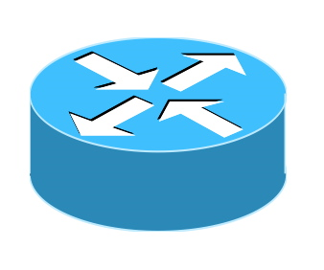
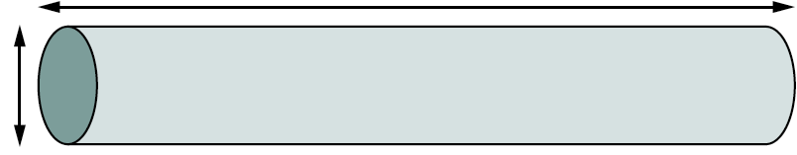
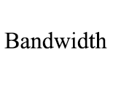
Nodal delay
Buffer
Buffer
Notes:
The following text is excerpted from Peterson and Davie:
Another term that is used to analyze and quantify networking performance is called latency (or delay). This is always measured in terms of time. It usually has three components (if we ignore nodal processing delay): 1) Transmit delay, 2) Queuing delay and 3) Propagation delay.
There are certain situations where it’s important to measure time to send a message from one end of the network to the other end and back. This is called Round Trip Time.
Transmission delay is the time taken by the node to put the links on the medium from its output buffers.
Queuing delays are because of packet switches since packet switches need to store packets before forwarding them on a link. If the output queue of a link is already full, the new packets will have wait.
Propagation delay is the time taken for the signal representing the bit to propagate at the speed of the light to the other end. Propagation delay = distance/ speed of light which is 3 x 10^8 in vacuum; 2.3 x 10^8 in a cable and 2.0 x 10^8 in a fiber.
Bandwidth and delay together combine to define the performance characteristics of a given link/channel. The relative importance, however, depends on the application. For some applications, latency dominates bandwidth. For example, a client that delivers one byte message and receives one byte message from the server is latency bound. Assuming no computation is involved (no nodal delay), the application will perform much different on a 100 ms RTT link than on 1 ms RTT link.

Slide 43
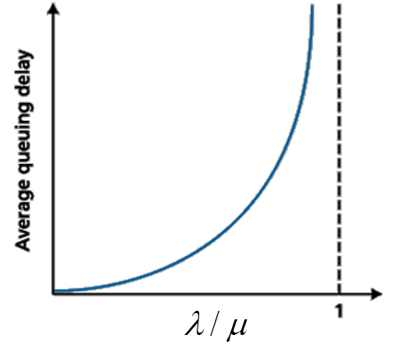
Queueing delay
(due to transient overload where instantaneous load exceeds service capacity)
Typical arrival rate: λ
Typical service rate: µ
Customer Arrivals
Buffer
Server
What happens when λ approaches (or exceeds) µ?
Solution: Change server speed (μ) to keep ρ below a certain value.
ρ = λ / μ
Traffic intensity (or utilization ratio)

Slide 44
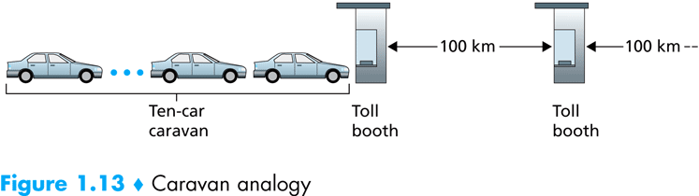
Exercise:
Comparing transmission and propagation delay
Cars travel between booths at 100 km/hr (propagation time)
Toll booth takes 12 sec to service car (transmission time)
Analogy: car ~ bit; caravan ~ packet
How long until caravan is lined up before 2nd toll booth?
Figure Credit: “Computer Networking: A Top Down Approach” by Kurose and Ross
Notes:
Comparing Transmission and Propagation Delay
Newcomers to the field of computer networking sometimes have difficulty understanding the difference between transmission delay and propagation delay. The difference is subtle but important. The transmission delay is the amount of time required for the router to push out the packet; it is a function of the packers length and the transmission rate of the link, but has nothing to do with the distance between the two routers. The propagation delay, on the other hand, is the time it takes a bit to propagate from one router to the next; it is a function of the distance between the two routers, but has nothing to do with the packet's length or the transmission rate of the link.

Slide 45
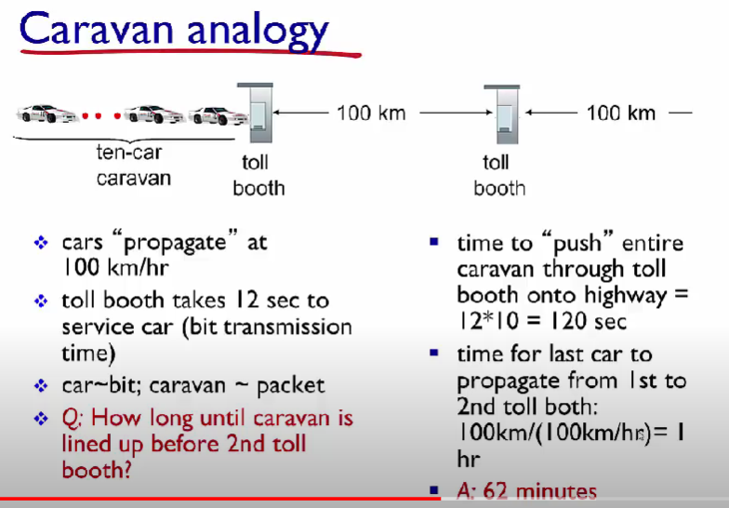

Slide 46
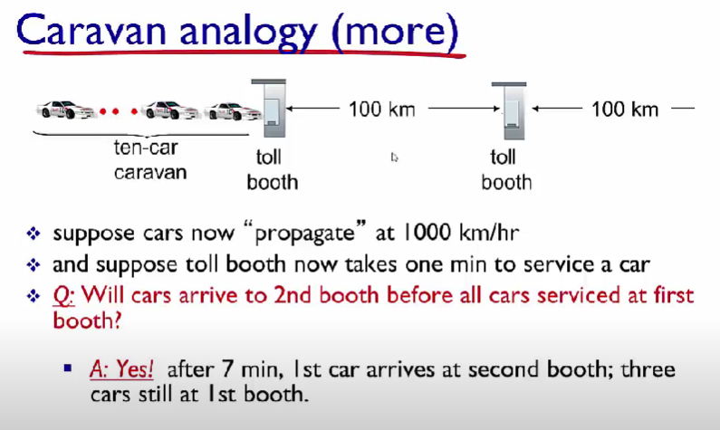

Slide 47
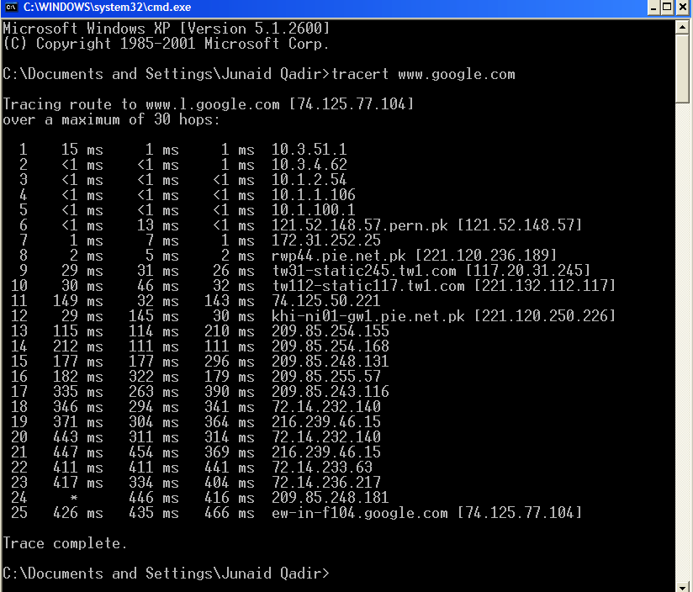
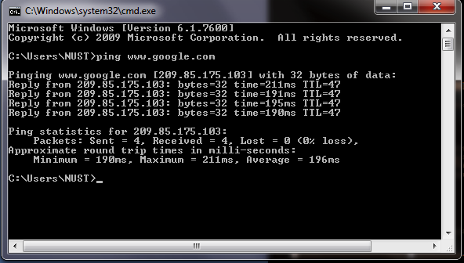
Activity
[ Measuring delay ]
Traceroute
Ping
Determines the end-to-end path taken by the packet and also the RTT delay to each intermediate hop
Determines the end-to-end RTT delay and the availability of the target host

Slide 48
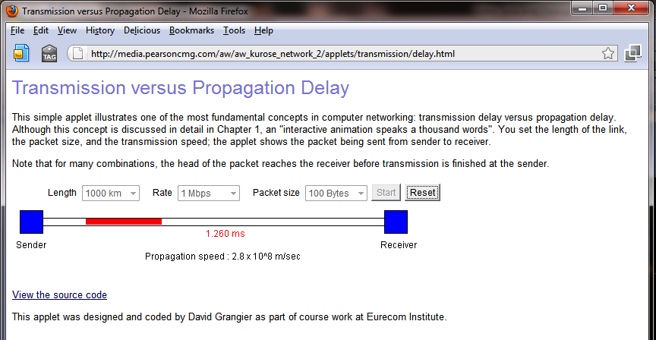
Activity
[ Applet: transmission, propagation delay]
http://media.pearsoncmg.com/aw/aw_kurose_network_2/applets/transmission/delay.html

Slide 49
3
Packet loss in computer networks

Slide 50
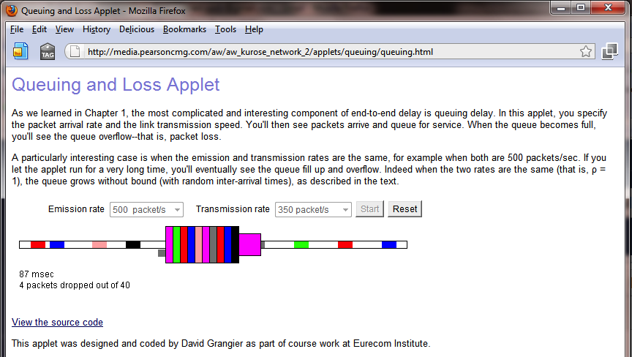
Class Activity
[ Applet: queueing and loss ]
http://media.pearsoncmg.com/aw/aw_kurose_network_2/applets/queuing/queuing.html

Slide 51
[ End of lecture ]

